Slide 1

Identity Access & Management
Sachin Agarwal

Slide 2
AGENDA
AWS Global Infrastructure
Introduction to IAM
Getting Started with IAM
IAM Users and Groups
IAM Policies
IAM Roles
IAM Best Practices
IAM Summary

Slide 3
AWS Global Infrastrucutre
AWS Regions
AWS Availability Zones
AWS Data Centres
AWS Edge Locations/Point of Presence
Infrastructure.aws

Slide 4
AWS REGIONS
AWS Regions are spread across the globe.
Naming Convention followed: us-east-1, us-east-2,ap-mumbai
A cluster of data centres is known as AWS Regions
Most of services are region-specific.

Slide 5
How to choose region?
Compliance with data governance and legal rules.
Proximity to Customers
Pricing
Available Services

Slide 6
AWS Availability Zones
Each region has multiple AZ's. (Min-2, Max-6)
Availability zones are nothing but data centers.
Availability zones are spread out in a region so that during any natural calamities at one availability zone it won't affect the other availability zone

Slide 7
AWS Edge Locations
Edge locations are used for caching the data.
For example, a user in India accessing a file from US east region for the first time the file will be accessed from US East region. If any user from India tries to access the same file they can directly access it from caching server in India.

Slide 8
OVERVIEW
IAM stands for Identity and Access Management.
IAM is web service that enables you to manage the access to AWS services and resources securely.
It helps you control who is authenticated and authorized to use these services and resources.
Used by and integrates well with virtually every other AWS service.
Service usage is FREE!

Slide 9
Features of iAM
Securely manage services and resources.
Creates IAM principals such as Users, Groups and Roles.
Allow/Deny access via IAM Policy.
Supports Identity Federation.
Provides Multi-Factor Authentication.
Provides Policy Simulator.

Slide 10
IAM Terminologies
Resources: Resources are the things on which actions can be taken. Example: EC2 instances are resources so someone who has the power to start or stop an instance, they are acting on a resource.
Principals: Things that can take action. So principals act and they act upon resources. It includes users, groups and roles. These are also called as Identities.
Users : IAM users are entities created in AWS and have permissions to perform some actions.
Group – Collection of IAM users.
Role – An identity that grants permission.

Slide 11
Getting started with iam
IAM does not need region selection.
Why to use sign-on link provided under Welcome tab.
This must be used only when needed as it’s a root account user which has all administrative privilege with unrestricted access. You should use it for loin only when needed. Best practice is to create users with appropriate access.
Once you have created the individual user account, you are going to provide them that link to sign-in to their account.
https://069725795960.signin.aws.amazon.com/console
When creating Access key its important to store it at safe place as you will need it to access the AWS services via API or CLI.

Slide 12
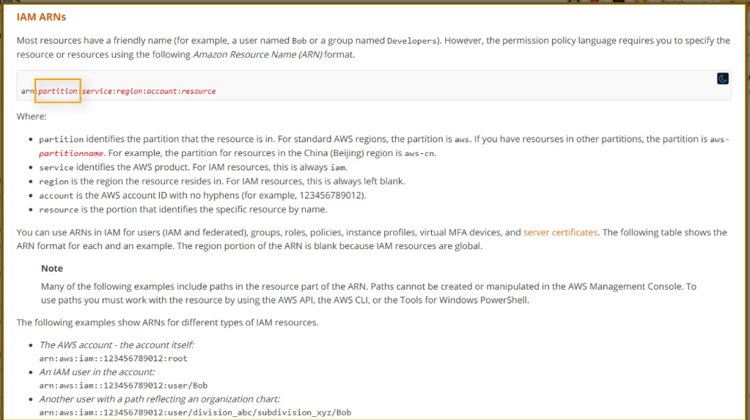
IAM Users and GROUPS
We will see here how to create users, groups, roles and policies.
IAM User and IAM Group by default has no permissions to access AWS resources. This is called as “Default Deny” or “Non-Explicit Deny”.
IAM users and groups should have be given least privilege (i.e. only the required) access to the AWS resources.
Each resource/user is associated with ARN (Amazon Resource Name).
ARN are important part of IAM policies.

Slide 13
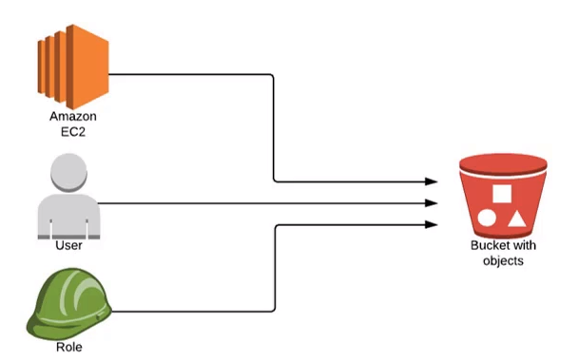
IAM Policies
A policy is an entity in AWS that, when attached to an identity or resource defines their permissions.
A policy contains different Permissions, determine whether the request is allowed or denied.
Policies are stored in AWS as JSON documents.
Policy is attached to either principals (Users, Roles or Groups) or to resources (e.g. S3 bucket).
Example: An external user, EC2 instance and IAM role has to access the S3 bucket. You need to define existing policies.

Slide 14
IDENTITY BASED POLICIES
Policies that you can attach to a principal (or identity) such as an IAM user, role or group.
These policies control what actions that identity can perform, on which resources, and under what conditions.
Categorized into 2 types:
Managed Policies : Standalone policies that you can attach to users or groups in AWS account. (AWS Managed, Customer Managed)
Inline Policies : Policies you create and manage which are embedded directly into single user group or role.

Slide 15
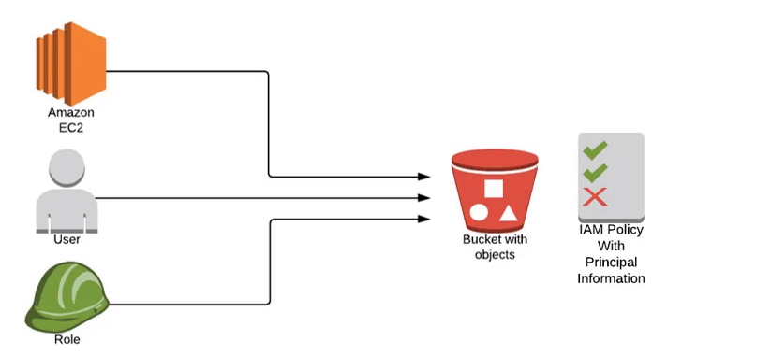
RESOURCE BASED POLICIES
Policies that you attach to a resource, such as S3 bucket.
These policies control what actions a specified principal can perform, and under what conditions.
These are inline policies and there are no managed resource-based policies.

Slide 16
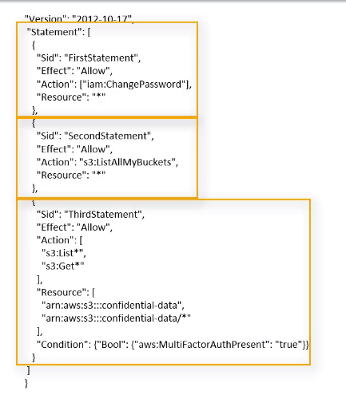
TEMplate of an IAM policy
If a policy includes multiple statements, AWS applies a “logical OR” across the statements at evaluation time. If multiple policies are applicable to a request, then AWS applies a “logical OR” across the policies at evaluated time.
SID –Statement Identifier

Slide 17
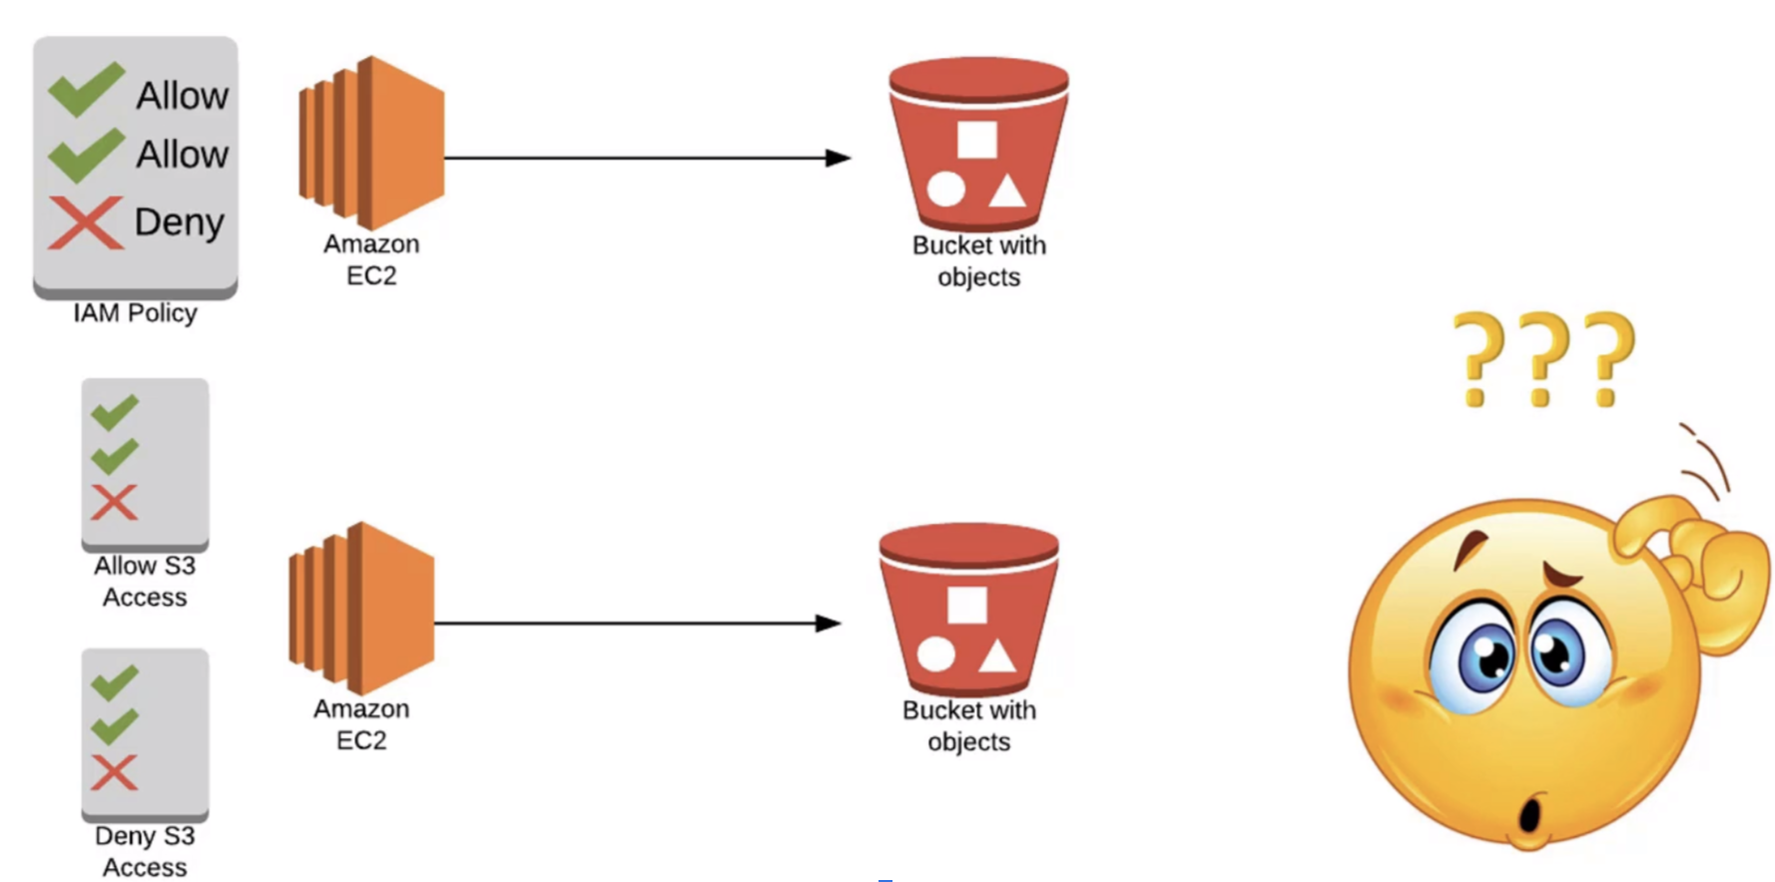
Conflicting permissions

Slide 18
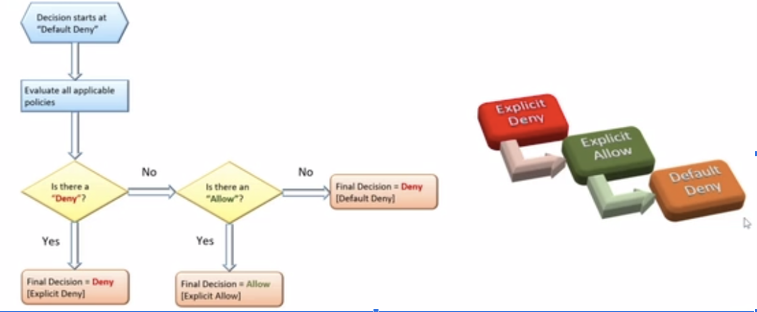
POLICY EVALUATION LOGIC

